Slide 1
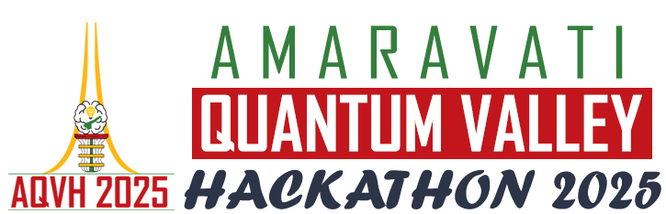

Amaravati Quantum Valley
Hackathon 2025
Problem Statement ID – AQVH918
Problem Statement Title - Identify anomalies in transaction data using QML
Theme - Quantum ML: Fraud Detection
PS Category- Software
Team ID – 1-5354121@23911A3530
Team Name (Registered on portal) - TATTVA

Slide 2
Quantum Eye: Real Time Fraud Detection
TATTVA
Credit card fraud is hard to detect due to massive, complex data and evolving tricks.
We combine QML with classical data techniques to make the model efficient.
Our quantum model reveals hidden fraud signals better than classical models, boosting accuracy and cutting false alarms.
This is one of the first times quantum digital twins are used for fraud detection.

Slide 3
TECHNICAL APPROACH
TATTVA
Technologies Used:
  Programming Languages: Python.
  Frameworks: Pennylane (QML & IBM integration), NumPy, Pandas, Scikit-learn, PyTorch.
  Cloud Infrastructure: IBM Quantum Cloud, Google Colab.
  Hardware: IBM Quantum Devices.

Slide 4
TECHNICAL APPROACH
TATTVA
Step | Process | Tools Used
1. Data Collection | Gathers transaction datasets (e.g., Kaggle credit card fraud dataset) | Kaggle API, wget, curl
2. Data Preprocessing | It scales to [-1,1], apply PCA to reduce to 4 principal features. | NumPy, Scikit-learn
3. Quantum Encoding | It maps the features to 4 qubits using RY angle embedding. | PennyLane
4. QDT Autoencoder Training | To train a 10-layer hybrid variational quantum autoencoder (RX, RY, RZ + CNOT gates) on normal data. | PennyLane, PyTorch
5. Anomaly Detection | Uses for reconstruction error + thresholding to flag fraudulent transactions. | PennyLane, IBM Quantum Backend

Slide 5
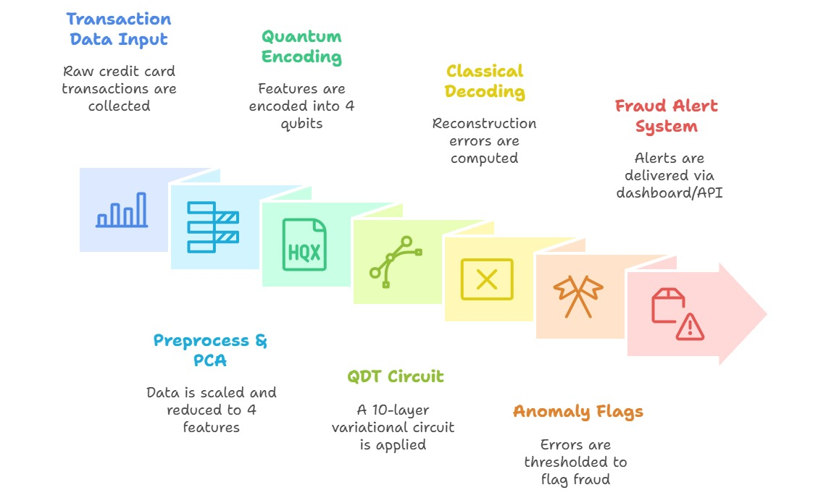
TECHNICAL APPROACH
TATTVA

Slide 6
FEASIBILITY AND VIABILITY
TATTVA
Technical: Pennylane enables 4-qubit QDT circuits with an accuracy of 89% achieved on Kaggle dataset in Google Colab.
Operational: Integrates with banking APIs and scalable on 4 qubits for real time fraud alerts.
Key Mitigations
  Noise: Zero noise extrapolation ensures reliable results on IBM hardware.
  Data: Synthetic data via SMOTE augments training.
  Scalability: Classical PCA reduces quantum demands, enabling real-time use.

Slide 7
FEASIBILITY AND VIABILITY
TATTVA
Challenge | Impact | Mitigation
Quantum Noise | Reduced accuracy in anomaly detection | Use PennyLane’s Zero-Noise Extrapolation (ZNE); optimize circuit depth
Data Privacy | Limited access to real-world fraud data | Use anonymized Kaggle dataset; generate synthetic data to enrich samples
Scalability | High latency when running on quantum hardware | Pre-train models on simulators; use hybrid (classical + quantum) processing

Slide 8
IMPACT AND BENEFITS
TATTVA
Target Audience: Banks, financial institutions, 50+ crore Indian users, global fraud teams.
Social: Safer transactions, fewer false declines gives stronger user trust.
Economic: Up to 30% cut in fraud losses, saving billions annually.
Environmental: Hybrid quantum systems are more efficient than large classical clusters.
Scalability: Ready to integrate into real pipelines, nationally & globally with less fraud, lower costs, greener tech, stronger confidence.

Slide 9
RESEARCH AND REFERENCES
TATTVA
Quantum machine learning algorithms for anomaly detection: A review by Sebastiano Corli, Lorenzo Moro, Daniele Dragoni, Massimiliano Dispenza, Enrico Prati in the year 2025. https://share.google/166x6XRaWypbayoAN
Quantum Machine Learning for Anomaly Detection in Consumer Electronics by Sounak Bhowmik and Himanshu Thapliyal in the year 2024. https://share.google/Z60PIvsAQTNfzJc87

